Slide 1
High incidence of HCV (re-)infections among PrEP users in the Netherlands: implications for prevention, monitoring and treatment
Elske Hoornenborg, MD
GGD Amsterdam
AIDS 2018, Amsterdam, the Netherlands
Notes:
In the next five min I will speak about Hepatitis C virus infections in the context of PrEP

Slide 2
Disclosures
 | Gilead Sciences
 | Unrestricted research grant paid to institute Study medication for PrEP demonstration project (AMPrEP in H-TEAM)

Slide 3


Methods
AMPrEP:
A PrEP demonstration project
376 MSM and transgender people
Choice of daily or event-driven PrEP
August 2015 – December 2020
Hepatitis C Virus (HCV) testing:
HCV antibodies and/or HCV RNA
Baseline* (prevalence 4.8%) and every 6 months
Study Outcomes for this analysis (2015 through 2017):
Incidence rates of HCV primary and re-infections
HCV genotype distribution and phylogenetic clustering
*Hoornenborg et al, AIDS 2017
Notes:
My institutes hosts the Amsterdam PrEP demonstration project, for 376 … etc
We tested the participants for …
We tested at baseline, before PrEP start, and found an unexpected high prevalence of 4.8%, and subsequently every 6 months
Study Outcomes …

Slide 4
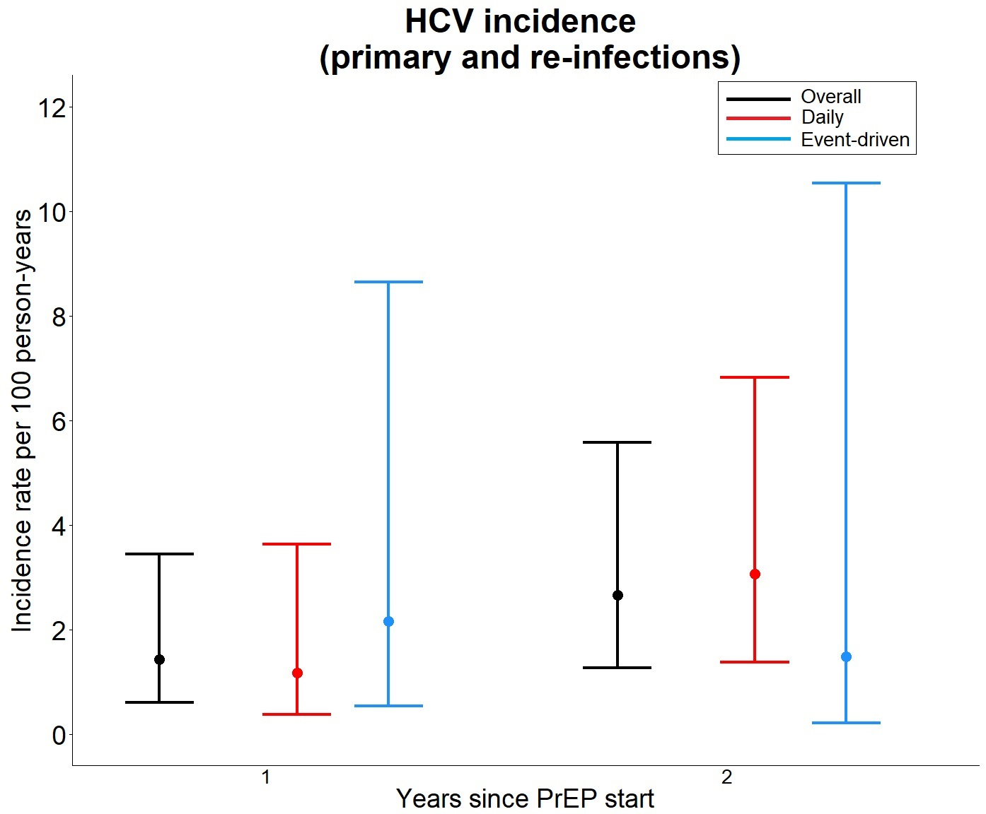
Results
Overall incidence rate of HCV: 1.9/100 py (95%CI 1.1-3.4) (n=12)
Incidence of primary infection: 1.0/100 py (95%CI 0.5-2.2) (n=6)
Incidence of re-infection: 25.5/100 py (95%CI 11.5-56.8) (n=6)
Notes:
We diagnosed 12 incident HCV cases, leading to an overall incidence rate of HCV of 1.9/100 py
6 of those 12 concerned primary HCV infections, IR was 1/100 py.
In the figure, you can see the overall incidence rate of primary HCV infection in the first year of PrEP use, and incidence rates disaggregated to daily and event-driven PrEP use
In the Figure on the right, we displayed HCV re-infection rates in the first year, overall and for both groups seperately, and in the second year on PrEP. . Please note the markedly different scale on the y-axis and the high re-infection incidence rates.

Slide 5
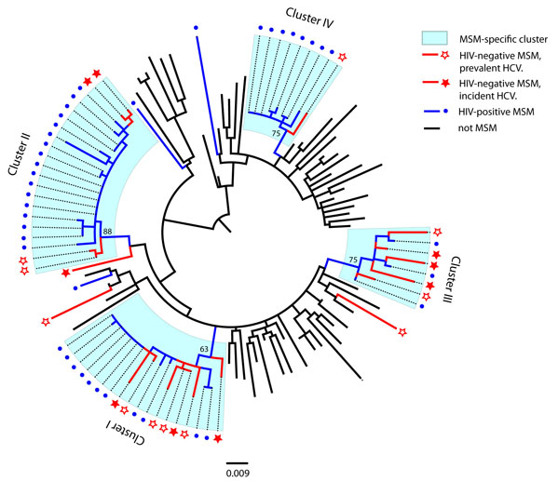
Genoype 1a HCV infections identified at baseline (n=11) and during follow-up (n=9) among AMPrEP participants, the Netherlands
Notes:
Here, you see a phylogenetic tree of HCV 1a infections. Red stars represent AMPrEP study participants; open red stars prevalent infections at baseline, closed red stars incident HCV infections. Blue dots indicate hiv+ MSM with HCV infection, and in black other risk groups. Phylogenetic analysis revealed that 8/9 incident HCV-1a infections were part of 4 large MSM-specific HCV-1a clusters containing MSM with and without HIV.

Slide 6
Discussion/conclusion
MSM on PrEP at risk for HCV infection: IR 1.9/100 py
High HCV re-infection: IR 25/100 py
HCV incidence rates comparable to those in HIV positive MSM
High degree of phylogenetic clustering between HIV positive and HIV negative MSM on PrEP suggests shared transmission networks
  Routine HCV testing, prompt treatment and interventions if needed for MSM starting with and using PrEP
Notes:
We suggest routine HCV testing of MSM on PrEP, prompt referral and treatment for those who test positive, and the use of prevention interventions if one not infected with HCV.

Slide 7




Acknowledgements
4/6
Dept. of Infectious Diseases
GGD Amsterdam
Laboratory
Paul Oostvogel
Sylvia Bruisten
Ineke Linde
Karin Adams
Dewi Usmany
Homeyra Amir
Khosravi Agchay
All analists
All AMPrEP participants
AMPrEP team
Maria Prins and Henry de Vries (PI)
Roel Achterbergh, Kees de Jong, Ilya Peters,
Princella Felippe, Myra van Leeuwen,
Maarten Schim van der Loeff, Udi Davidovich
Liza Coyer, Yvonne van Duijnhoven
Arjan Hogewoning, Gerard Sonder,
Lia Peters, Titia Heijman, Adriaan Tempert
Kim Visser and Roelien Prins, Marjo Broeren
GGD R&D
ZonMW grant nr 522002003
AIDS fonds, grant nr 2013169
All H-TEAM colleagues
All H-TEAM funders
Sanquin
Thijs van de Laar
RIVM
Ardine de Wit
Maria Xiridou
Silke David

